Slide 1
Peripheral Devices
Input-Output Interface
Asynchronous Data Transfer
Modes of Transfer
Priority Interrupt
Direct Memory Access
Input-Output Processor

Slide 2
Asynchronous Data Transfer
→Synchronous Data Transfer: Clock pulses are applied to all registers within a unit and all data transfer among internal registers occur simultaneously during the occurrence of a clock pulse. Two units such as CPU and I/O Interface are designed independently of each other. If the registers in the interface share a common clock with CPU registers, the transfer between the two is said to be synchronous.
  →Asynchronous Data Transfer: Internal timing in each unit (CPU and Interface) is independent. Each unit uses its own private clock for internal registers. Asynchronous data transfer between two independent units requires that control signals be transmitted between the communicating units to indicate the time at which data is being transmitted. One way of achieving this is by means of STROBE(Control signal to indicate the time at which data is being transmitted) pulse and other method is HANDSHAKING(Agreement between two independent units).

Slide 3
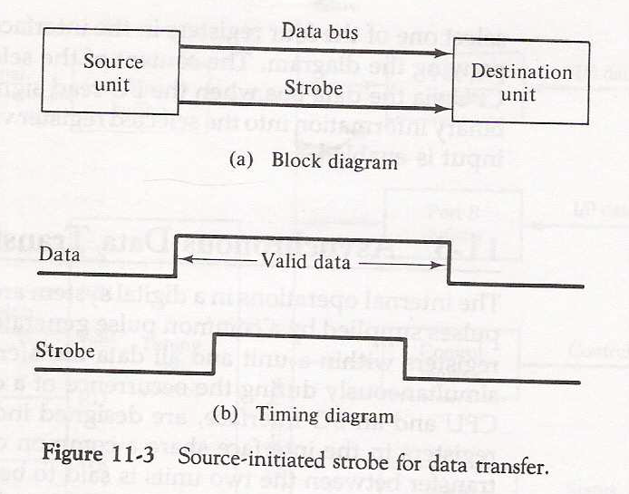
1
2

Slide 4
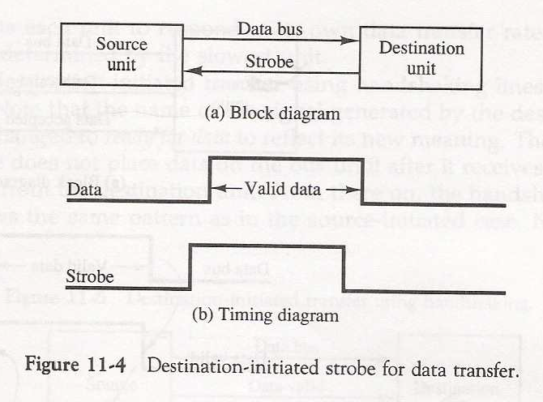
2
1

Slide 5
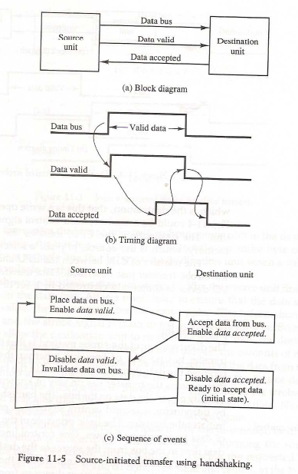

Slide 6
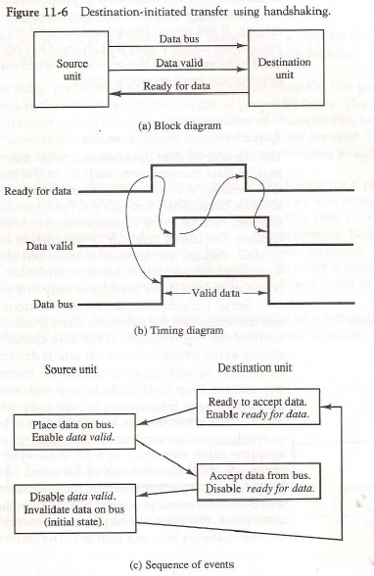
    Timeout : If the return handshake signal does not respond within a given time period, the unit assumes that an error has occurred.

Slide 7
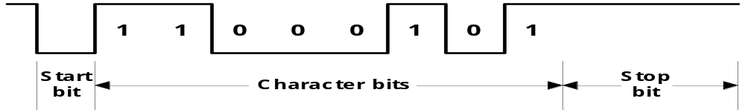
  Asynchronous Serial Transfer
    Synchronous transmission :
      The two unit share a common clock frequency
      Bits are transmitted continuously at the rate dictated by the clock pulses
    Asynchronous transmission :
      Binary information sent only when it is available and line remain idle otherwise
      Special bits are inserted at both ends of the character code
      Each character consists of three parts :
        1) start bit : always “0”, indicate the beginning of a character
        2) character bits : data
        3) stop bit : always “1”

Slide 8
    Asynchronous transmission rules :
      ① When a character is not being sent, the line is kept in the 1-state
      ② The initiation of a character transmission is detected from the start bit, which is always “0”
      ③ The character bits always follow the start bit
      ④ After the last bit of the character is transmitted, a stop bit is detected when the line returns to the 1-state for at least one bit time
    Baud Rate : Data transfer rate in bits per second
      10 character per second with 11 bit format = 110 bit per second

Slide 9
Universal Asynchronous Receiver Transmitter
A typical asynchronous communication interface available as an IC
Transmit
Bidirectional
Transmitter
Shift
data
data bus
Bus
register
register
buffers
Control
Transmitter
Transmitter
register
control
clock
Chip select
and clock
CS
Internal Bus
RS
Timing
Status
Receiver
Receiver
CS RS Oper. Register selected
register
control
clock
0 x x None
I/O read
RD
and
and clock
1 0 WR Transmitter register
Control
Receive
1 1 WR Control register
I/O write
WR
Receiver
Shift
data
1 0 RD Receiver register
register
register
1 1 RD Status register
Transmitter Register
- Accepts a data byte(from CPU) through the data bus
- Transferred to a shift register for serial transmission
Receiver Register
- Receives serial information into another shift register
- Complete data byte is sent to the receiver register
Status Register Bits
- Used for I/O flags and for recording errors
Control Register Bits
- Define baud rate, no. of bits in each character, whether to generate and check parity, and no. of stop bits

Slide 10
Overview
Peripheral Devices
Input-Output Interface
Asynchronous Data Transfer
Modes of Transfer
Priority Interrupt
Direct Memory Access
Input-Output Processor

Slide 11
Modes of Transfer
Binary information received from external device is usually stored in memory.
Information transferred from central computer into an external device originates in the memory unit.
The CPU merely execute I/O instructions and may accept data temporarily but ultimate source or destination is the Memory Unit.
Data transfer between central computer and I/O devices may be handled in a variety of modes. Some modes use CPU as intermediate path and others transfer data directly to and from memory unit.
Data Transfer to or from peripheral can be handled in one of three possible modes :
  Programmed I/O
  Interrupt-Initiated I/O
  Direct Memory Access (DMA)

Slide 12
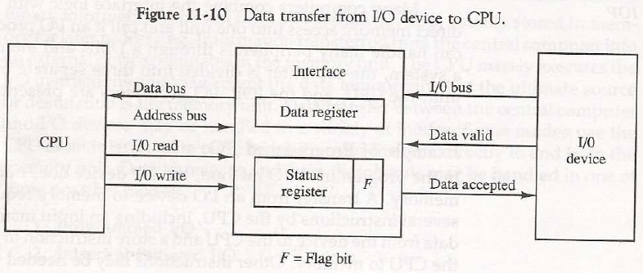
Input/output Organization <number>
Modes of Transfer – Programmed I/O

Slide 13
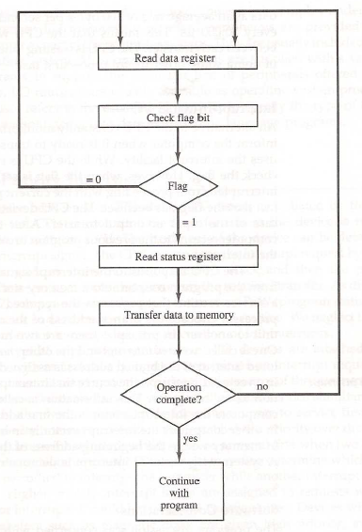

Slide 14
Programmed I/O
- Programmed I/O operations are the result of I/O Instructions written in computer program. Each data item transfer is initiated by an instruction in the program.
Usually, transfer is to and from a CPU register to peripheral. Other instructions are needed to transfer data to and from CPU and Memory
Transferring data under program control requires constant monitoring of the peripheral by CPU.
In programmed I/O method, CPU stays in a program loop until the I/O unit indicated that it is ready for data transfer. This is a time consuming process since it keeps the processor busy needlessly. It can be avoided by using Interrupt facility and special commands to inform the interface to issue an interrupt request signal when data are available for the device.

Slide 15
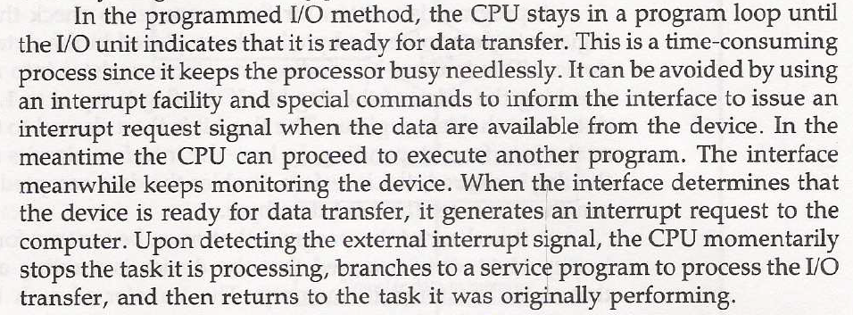
Interrupted I/O

Slide 16
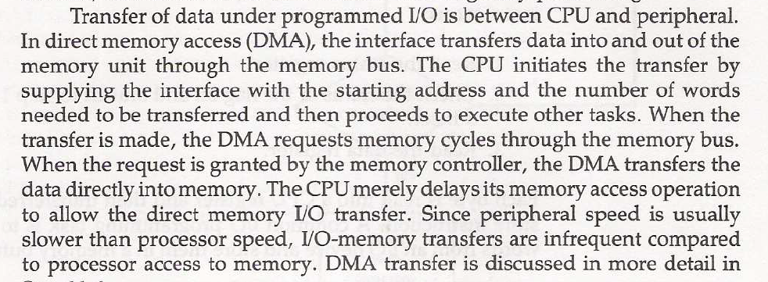
DMA

